Slide 1

Academic presentations
Malia Marks, PhD Student, Cambridge Department of Psychology

Slide 2

Things to consider: planning
Notes:
Should generally follow the logic of an academic paper, but likely shorter, just focusing on main points, and in a more ‘human’ voice.
Before making your presentation, make sure you’re clear on:
Who your audience is: are they experts or general? Are they academics or high schoolers? This should inform how much jargon you use and how formally you speak.
Why would your audience be interested in your topic? You may want to focus in on different aspects depending on your audience. When presenting in department, you should focus on your contribution to the field and the quality of your research plan. When presenting to policy makers, you should focus more on the real-world impact. (don’t leave either out, but just focus differently)
This should also inform what you put in your slides– do you include gifs and memes? Do you include reminders for definitions of technical language?

Slide 3

Things to consider: writing
Notes:
I sometimes prefer to present before I begin writing a large/important piece because this can help me organize my thoughts and find gaps in my research/argument
Do plan a structure for the presentation to make sure you hit all of the crucial points
Include references!

Slide 4
Structure
Introduction
- Welcome and introduction
Say who you are, why you are there
Mention anything else that’s significant, i.e., when you will be taking questions
Say what you’re going to say
  Set the scene, provide background
  Give the outline
Say it
  Get into more detail, give outline and analysis of the topic
  Investigation
  Issues
Say what you said
- Provide conclusions
- Repeat key messages and provide a resolution
Notes:
This will generally follow the structure of an academic paper, but much more pointed.
Any technical/jargon phrases should be defined as early as possible!

Slide 5

Visual aids
Notes:
People can read faster than you will talk. They also tend to focus visually more on your slides than you, which can pull their overall focus if the slide doesn’t reinforce what you’re saying. SO:
DO NOT put too much text on your slides. In general, do not type out full sentences, unless there’s an important quote or other valid reason.
DO NOT put overly distracting visuals on the slide. If you include pictures, these should reinforce what you’re saying. I would generally discourage gifs as the movement is going to distract people.
If you want to include a video, have it play while you’re not talking. Use this time as a moment to sip some water and/or briefly reflect on how the presentation is going so far.

Slide 6
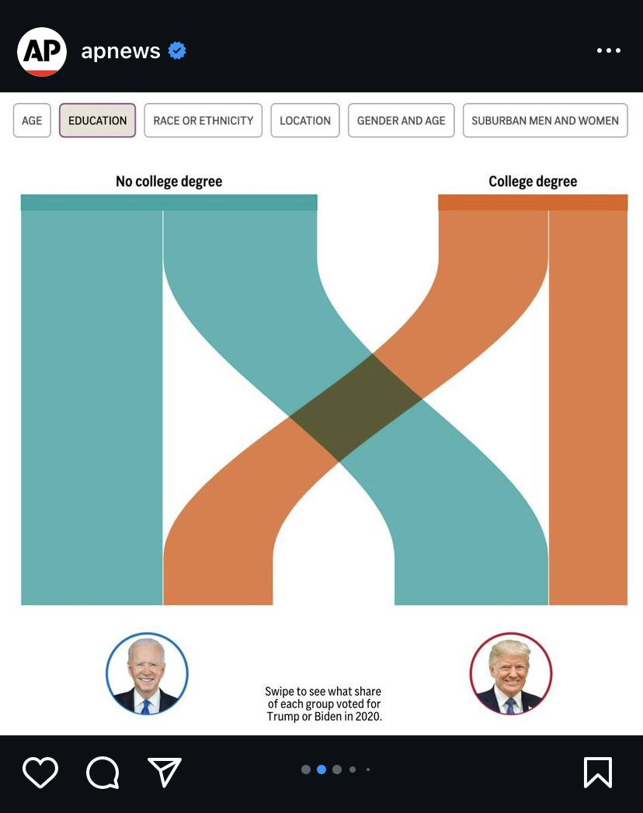
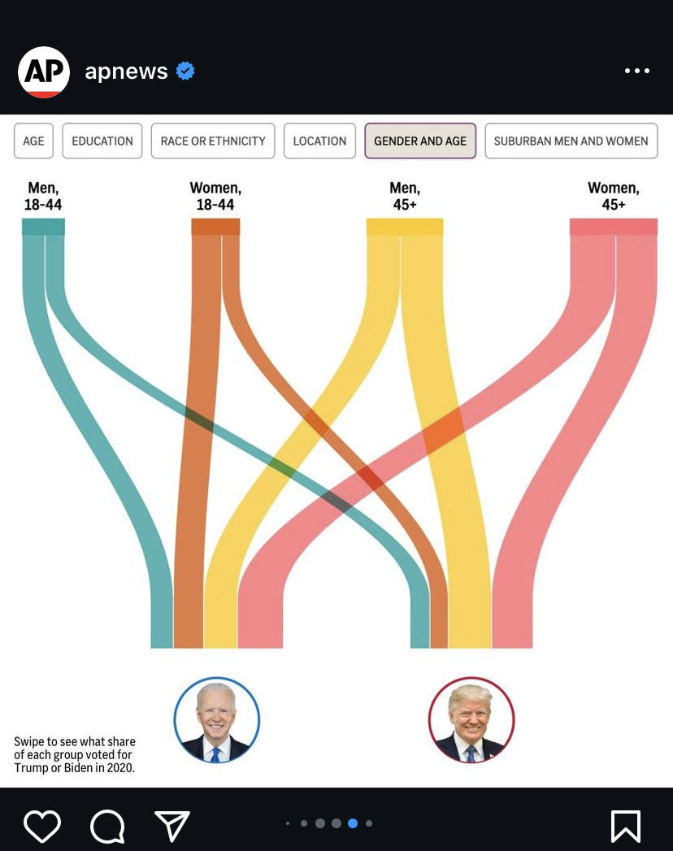
Visual aids
Notes:
When including graphs, make sure they are very easily interpretable so that the audience isn’t ignoring you to try and decipher your hieroglyphics.

Slide 7
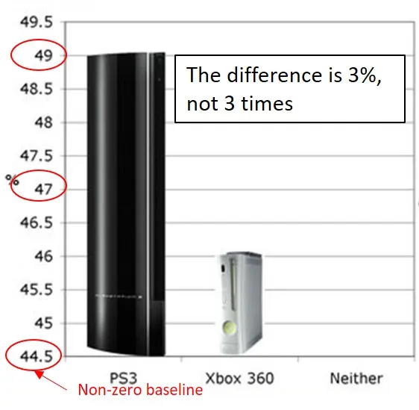
Visual aids
Notes:
When including graphs. Be careful with scaling, as this can lead to misinterpretations. This is something that R will sometimes automatically mess up, so check your graphs before adding them to your slides and manually adjust the scaling in your code if necessary.

Slide 9

Things to consider: on the day
Notes:
As you’re preparing for the presentation, practice like you want to perform.
Slow down. It’s common for people to speak really quickly when nervous.
If possible, have someone you know in the audience who you can look at if you get nervous, and who can give you subtle hand signals like ‘speak up’ or ‘slow down’
You’re going to mess up. It’s unlikely anyone will remember except for you.
Does anyone else have tips for nerves when presenting that I haven’t mentioned?

Slide 10
Continuous learning process
Draft
Reflect
Rehearse
Present
Revise
Notes:
This really emphasizes the importance of presenting to friends or colleagues beforehand. You’ll be able to revise rough patches before you’re in a high-stakes situation, and identify potential problems with your content and organization.
DO time yourself for rehearsals. Most presentations have time limits, and you may have to adjust your scope and level of detail to accommodate this.
DO ask your rehearsal partners for specific feedback. You know what may need work.
DO take advantage of opportunities to present at your college or for student societies. These are really great, low-stakes opportunities for practice, not just for that specific presentation, but for presenting in general

Slide 11

What makes a successful presentation
The audience learned something
The presenter learned something
Everybody had a good time
The presentation was memorable
You get a good grade/review
Notes:
Memorable is a big one- try to find a punchy quote or one-liner or a striking stat to open and close with.

